Slide 1



High-Fidelity Prototype Checkpoint
David Castro, Leyth Toubassy, Marie Chu, Becky Miller

Slide 2

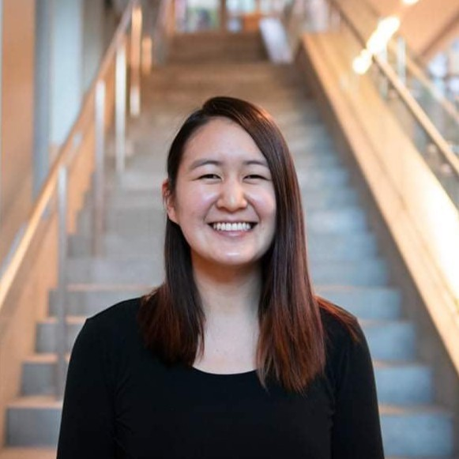

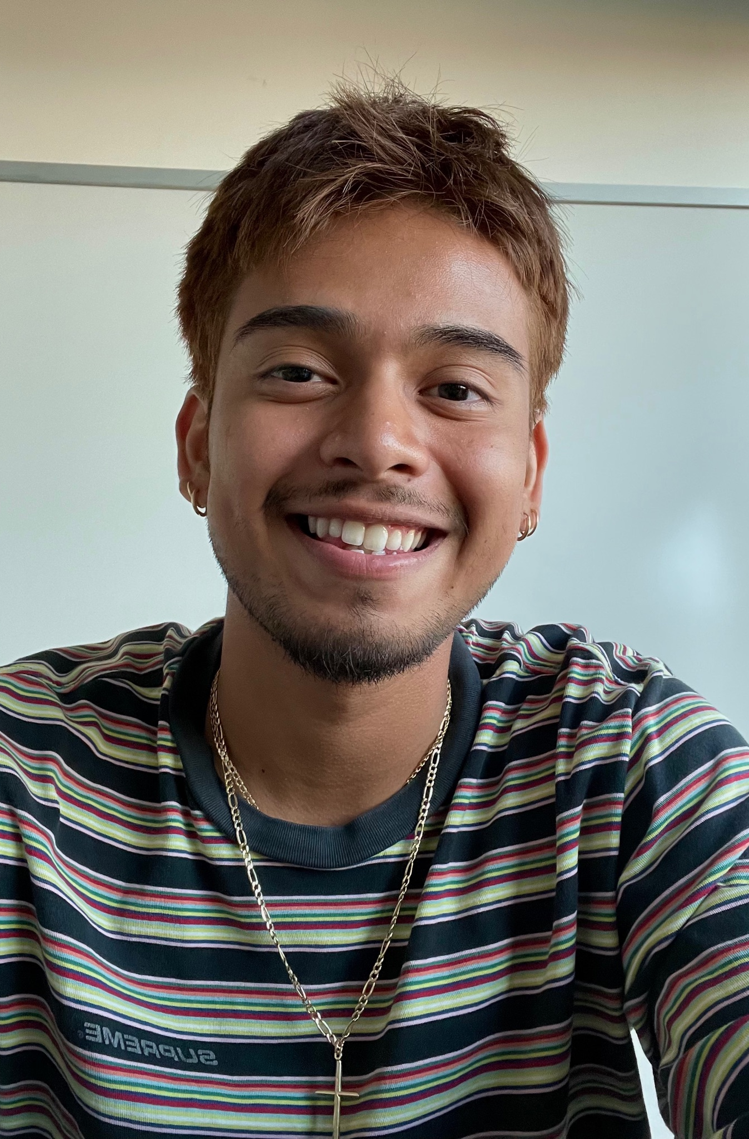
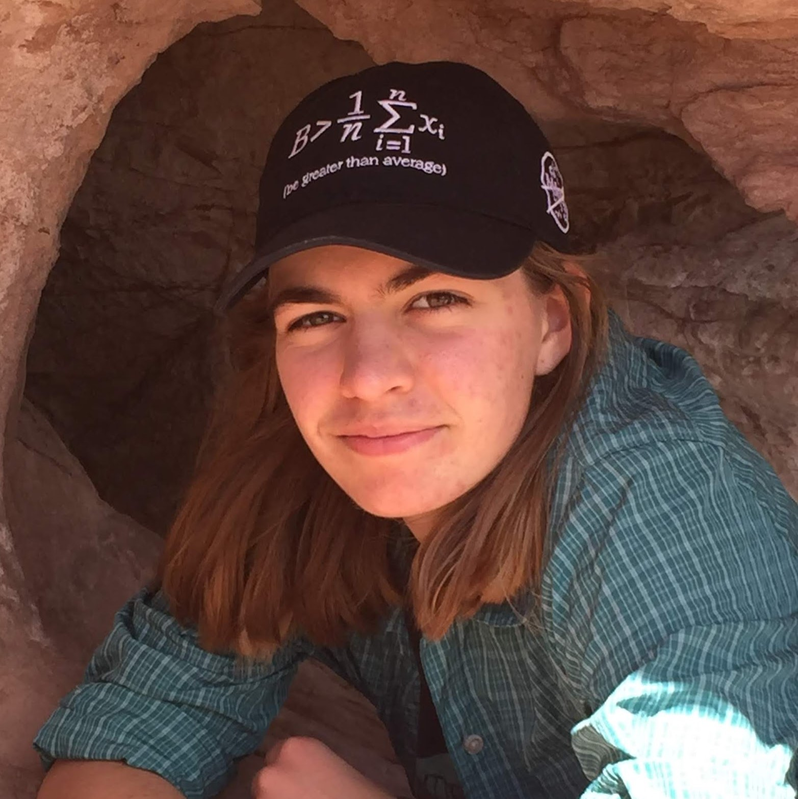

Our Team
Marie C.
Designer/Developer
Leyth T.
Designer/Developer
David C.
Designer
Becky M.
Designer/Developer

Slide 3
Learn art and build your community - one pixel at a time

Slide 4

Problem
Art^2
It’s difficult to continue learning art and creative expression beyond school because of perceived lack of skill and barriers to entry.
Collaborative, creative environment for users to learn pixel art on the go.

Slide 5
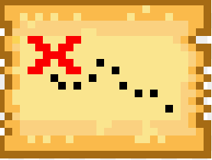
Presentation Roadmap
1. | Opening Slides
2. | Heuristic Evaluation Summary
3. | Product Revisions
4. | Prototype Implementation Status
5. | Live Demo

Slide 6
Heuristic Eval Summary

Slide 7

15 Severity 3 / 4 Violations
28 Severity 1 / 2 Violations
Our evaluators appreciated the minimalistic design, but thought the menu based navigation hid too many features, was unclear, and difficult to use. We also received feedback indicating that we should place more emphasis and focus on the collaboration and messaging elements of the app.
There were also a number of low severity recommendations regarding confirmation messages and pop ups.

Slide 8
High Severity
Toolbar arrow: arrow direction should flip when toolbar deployed
Pencil vs Bucket: no difference between pencil and bucket
Message input size: increase size of message box for sharing
Blank collaboration: allow collaboration on a blank canvas
Sharing mis-click: option to deselect friends when sharing
Artwork icon size: icons on collaborate page too small
Sharing clarity: “1 friend selected” text should be bigger
Discard Drafts: no option to discard unwanted art
Visibility of Sharing: unclear how to share
Home page carousel: unclear what the carousel on the home page is
Message collaborators: unclear how to message collaborators
Confusing canvas tools: unclear how to use tools on canvas
Navigation: navigation through menus is difficult
Save button: include a save function on the canvas page
Message notification: difficult to access messages

Slide 9
High Severity
Toolbar arrow: arrow direction should flip when toolbar deployed
Pencil vs Bucket: no difference between pencil and bucket
Message input size: increase size of message box for sharing
Blank collaboration: allow collaboration on a blank canvas
Sharing mis-click: option to deselect friends when sharing
Artwork icon size: icons on collaborate page too small
Sharing clarity: “1 friend selected” text should be bigger
Discard Drafts: no option to discard unwanted art
Visibility of Sharing: unclear how to share
Home page carousel: unclear what the carousel on the home page is
Message collaborators: unclear how to message collaborators
Confusing canvas tools: unclear how to use tools on canvas
Navigation: navigation through menus is difficult
Save button: include a save function on the canvas page
Message notification: difficult to access messages
Notes:
First 2 no longer apply
Next 5 are quick fixes
Visibility of sharing is a false positive - also walkthrough

Slide 10
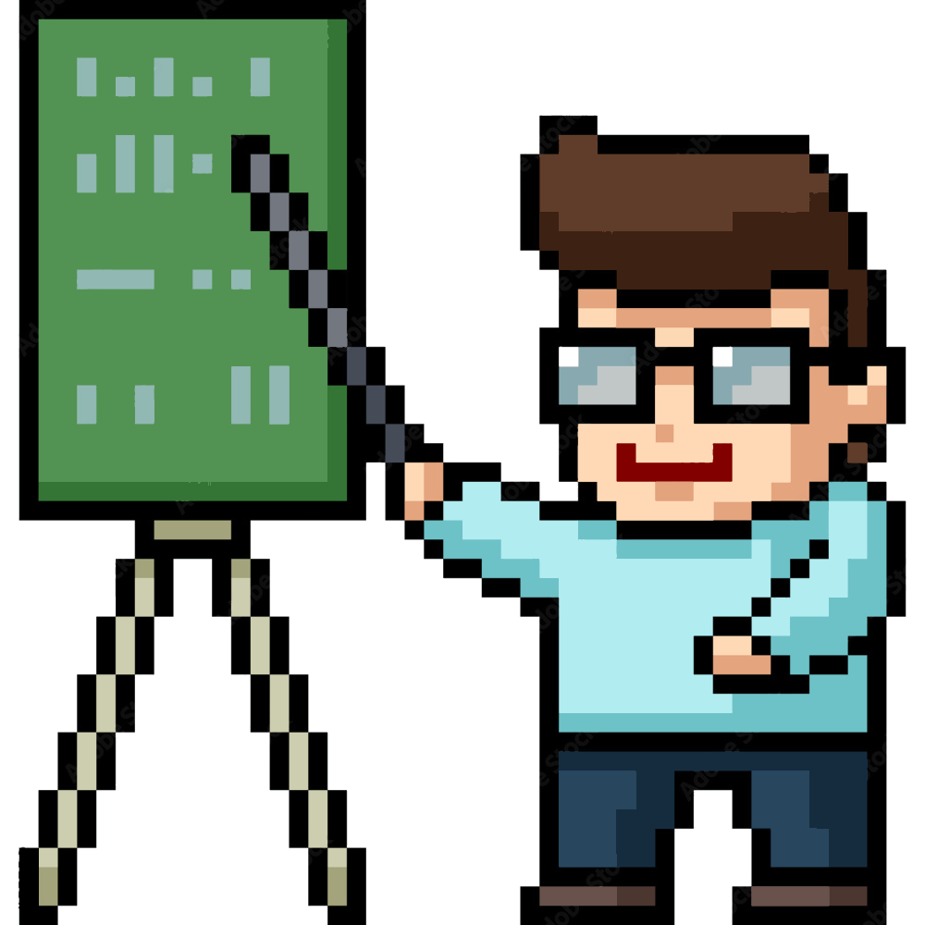
Tutorial
Video walkthrough of key app features
Prompted when app is first opened
Accessible throughout lifetime of the app
Focuses on how to find tools, how to navigate to lessons

Slide 11
Product Revisions

Slide 12
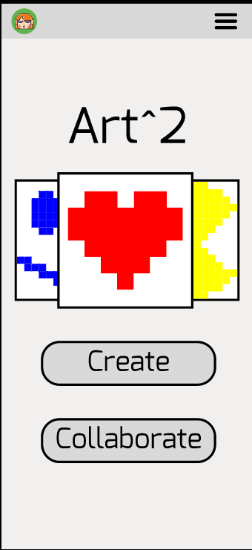
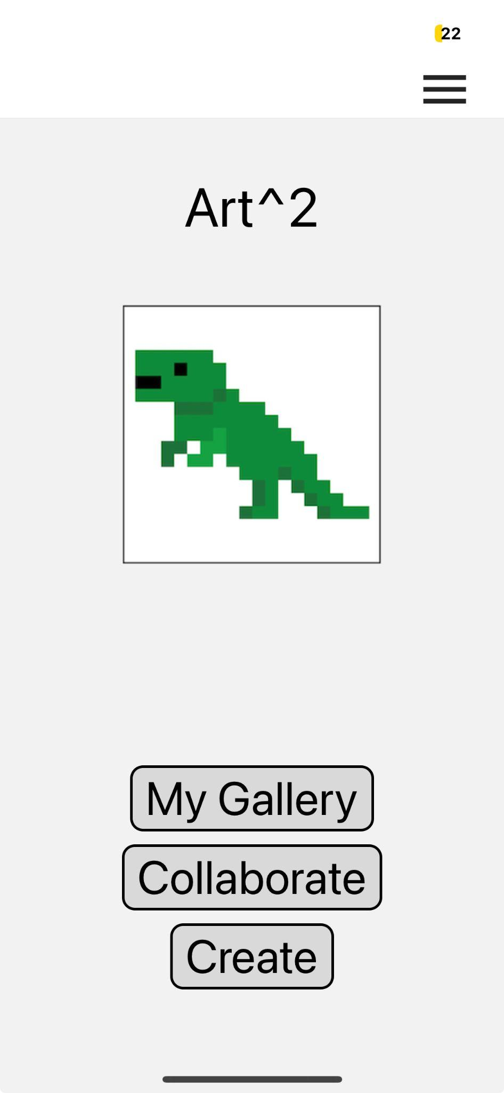
Home
Before
After

Slide 13
Home Rationale
Before
After
10. Home page carousel: unclear what the carousel on the home page is
General feedback: things are too hidden in the menus
Keeps focus on user’s work
More visibility of primary actions

Slide 14
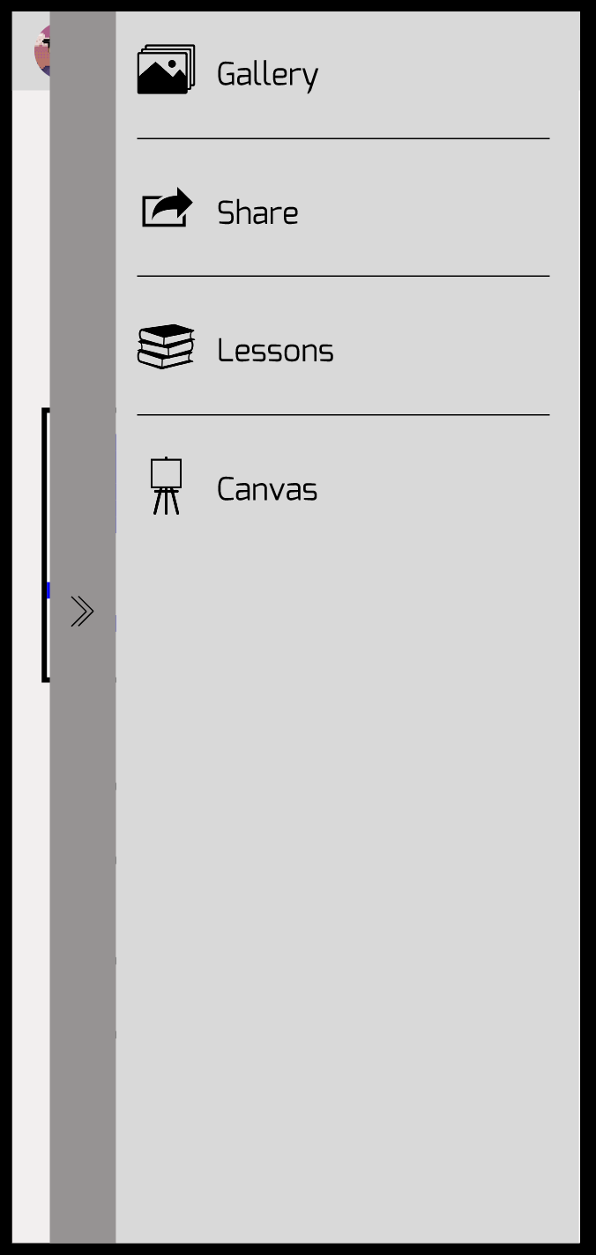
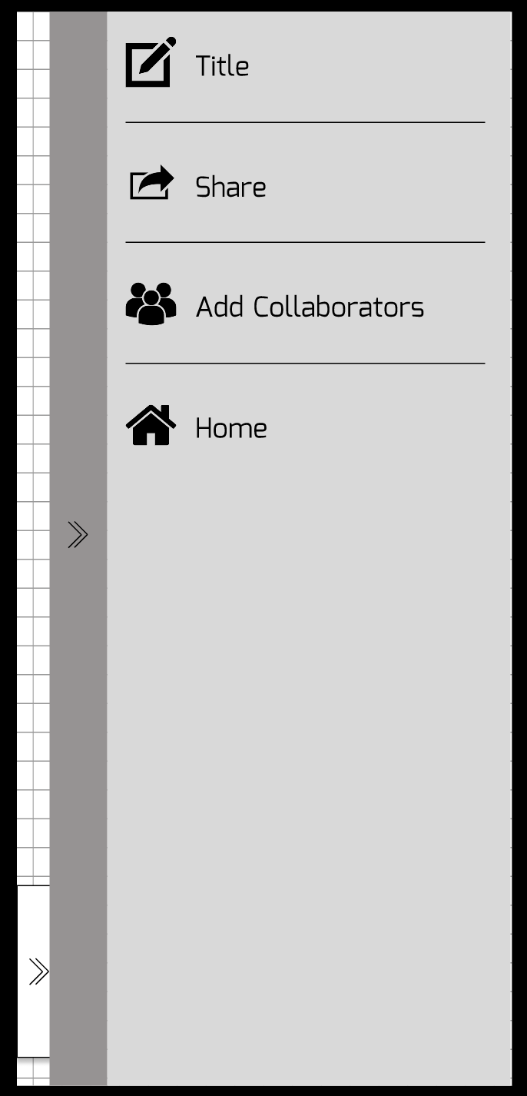
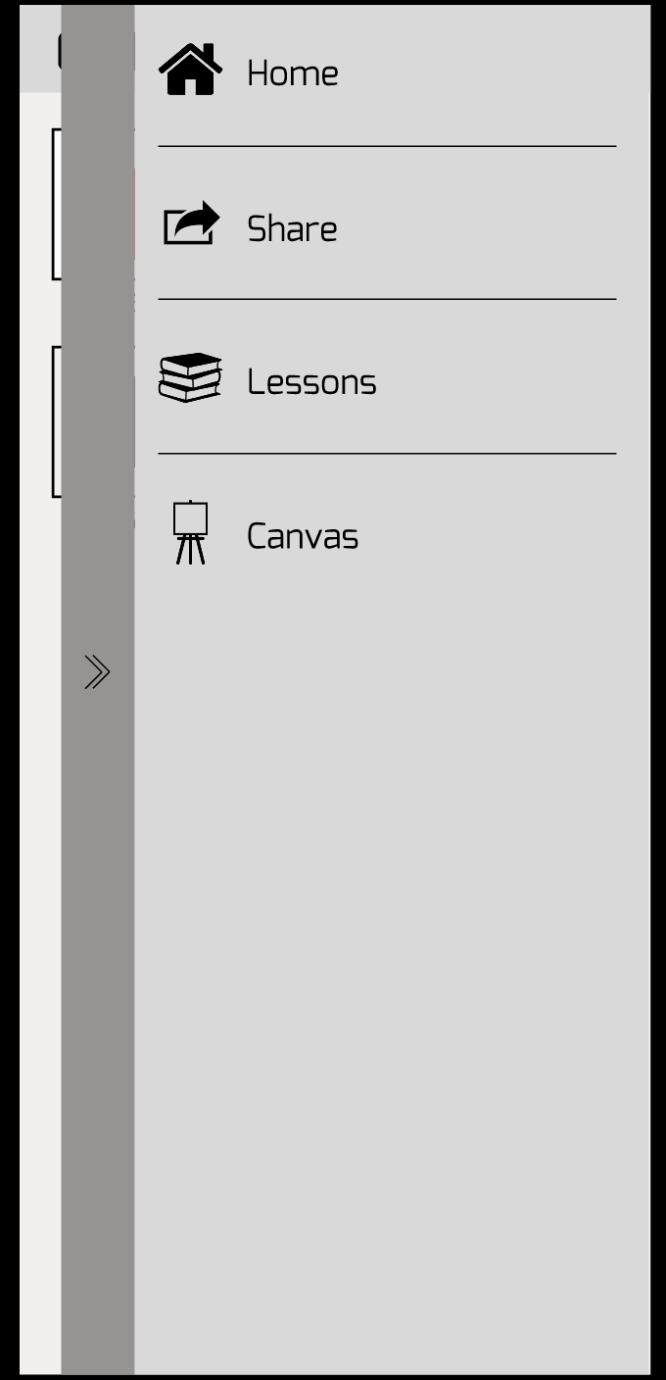
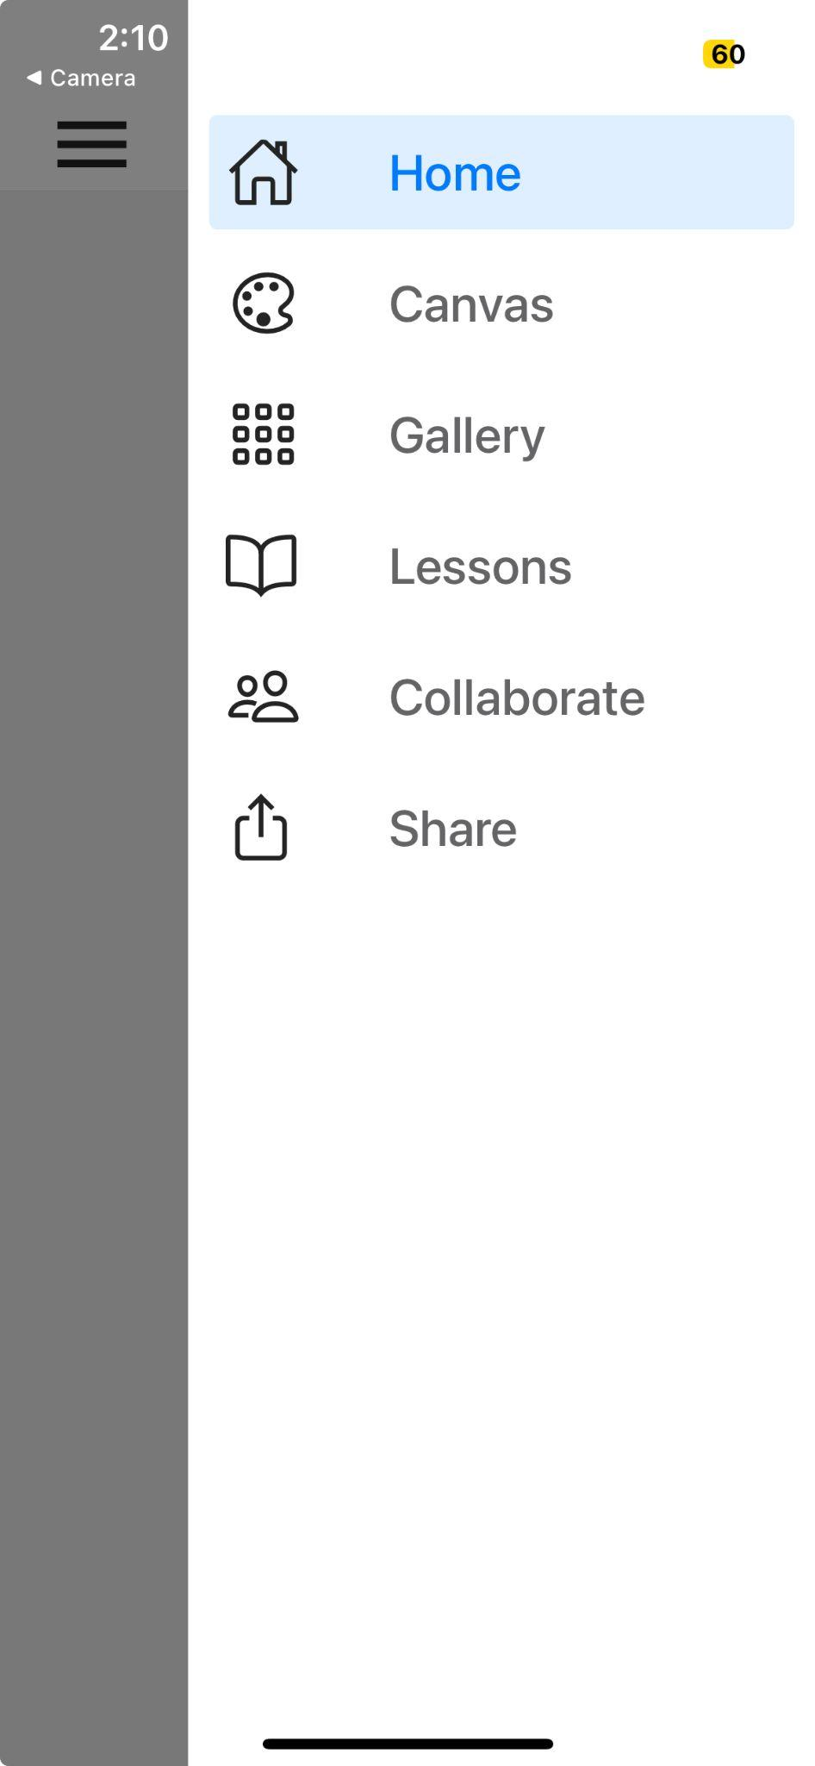
Navigation Menu
Before
After

Slide 15
Navigation Menu
Rationale
Before
After
13. Navigation: navigation through menus is difficult
General feedback: inconsistency of menus is confusing
finding features in menus inconvenient
Same menu anywhere there is a hamburger menu
Many features duplicated out of menu system

Slide 16
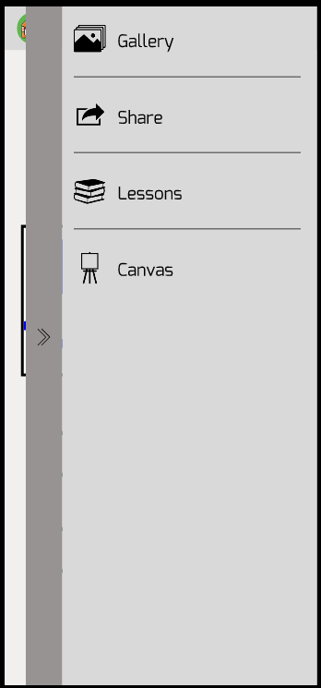
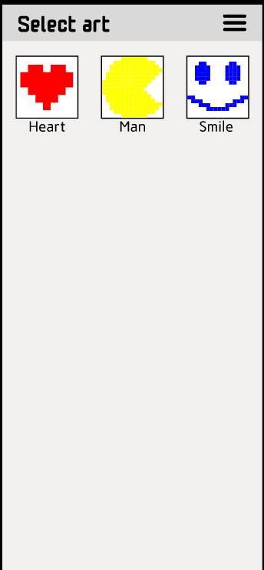
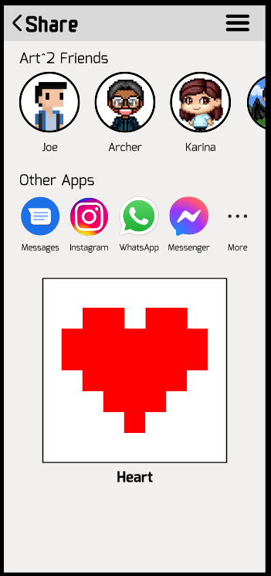
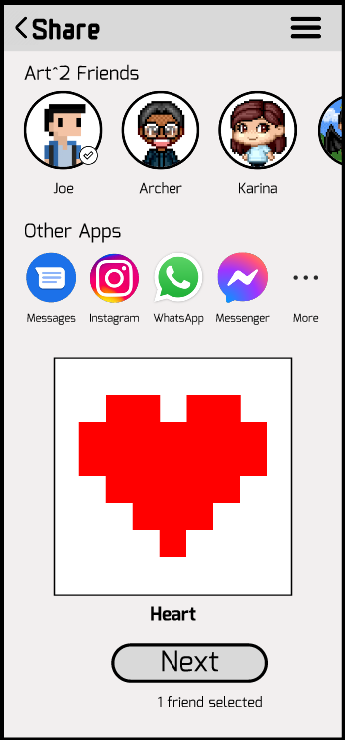
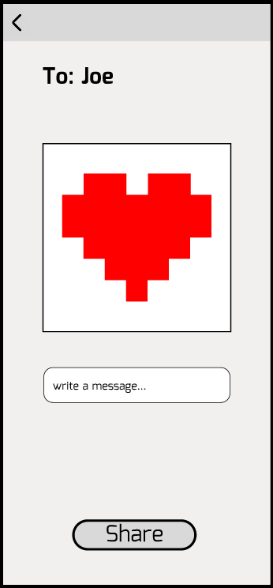
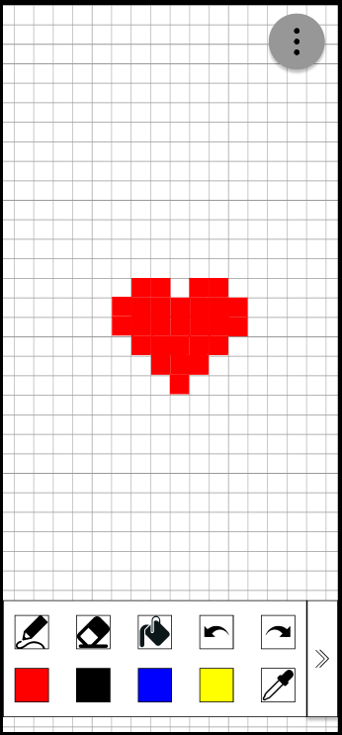
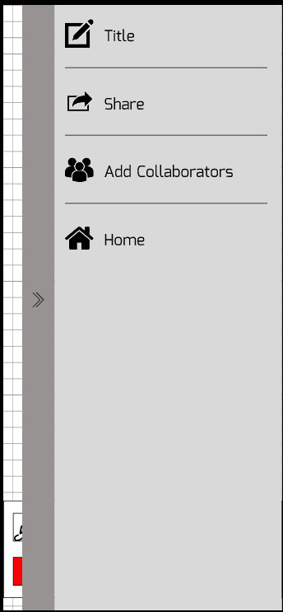
Share/Collaborate
Before

Slide 17
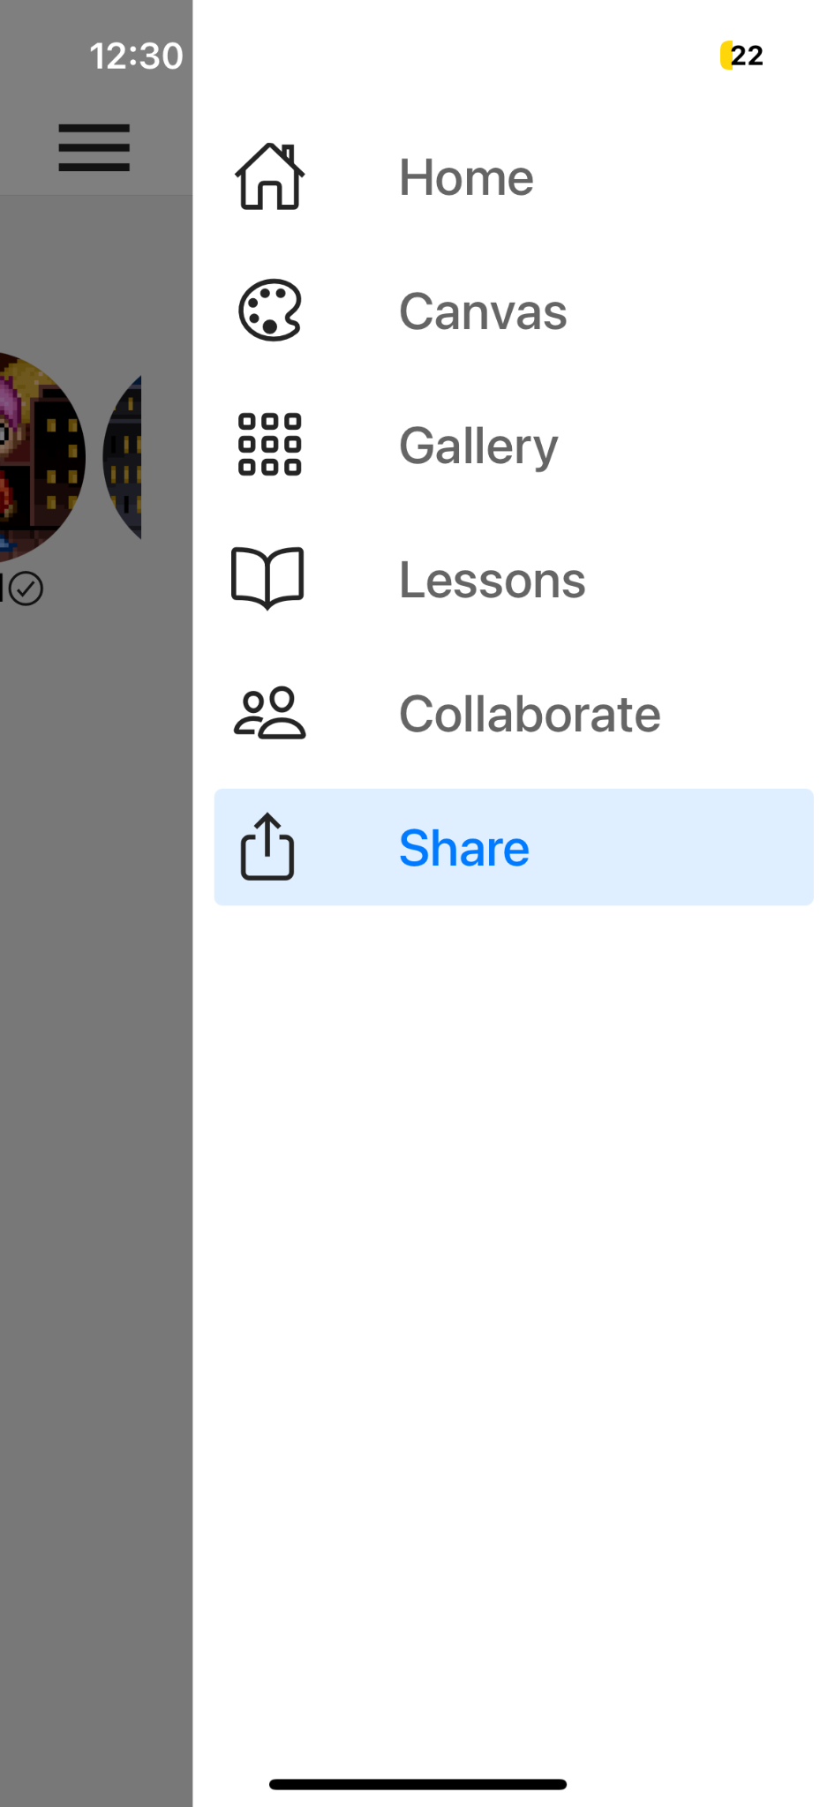
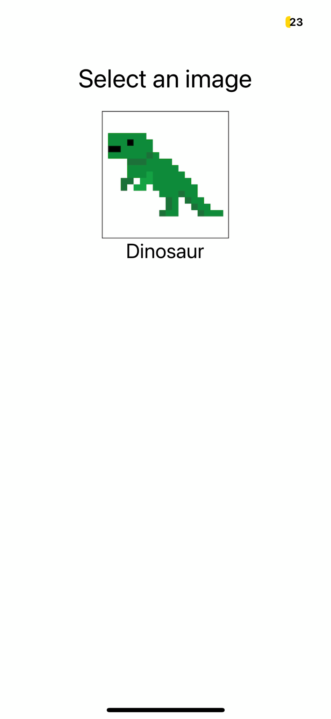
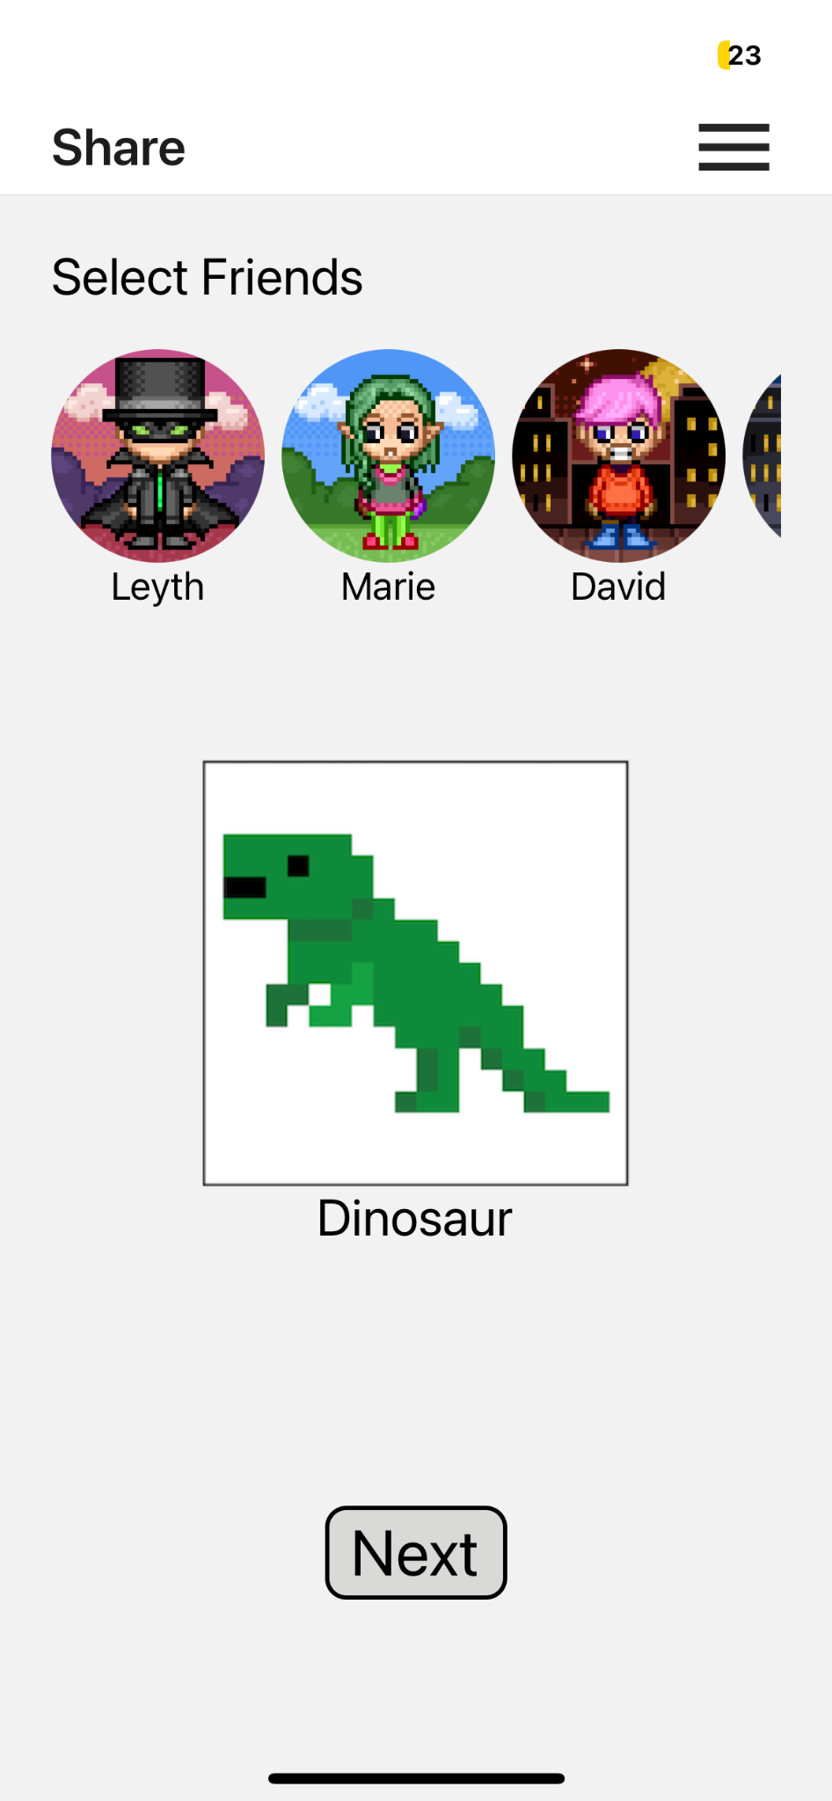

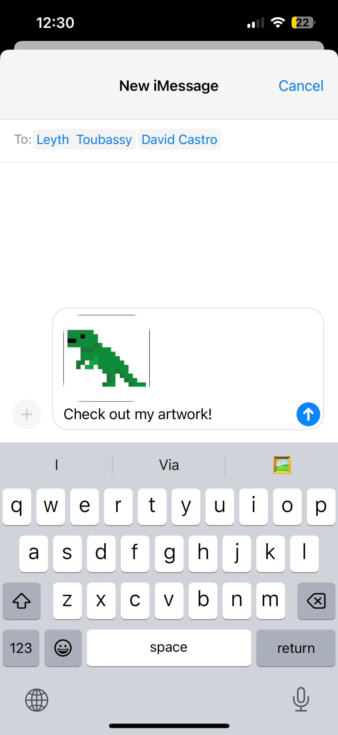
Share/Collaborate
After

Slide 18
Rationale
Share/ Collaborate
Before
3-7. Share/collaborate flow: message size, blank canvas, unselect, icon size, text size
Implementation considerations: simpler to implement
Simplified workflow
Improved aesthetics
After

Slide 19
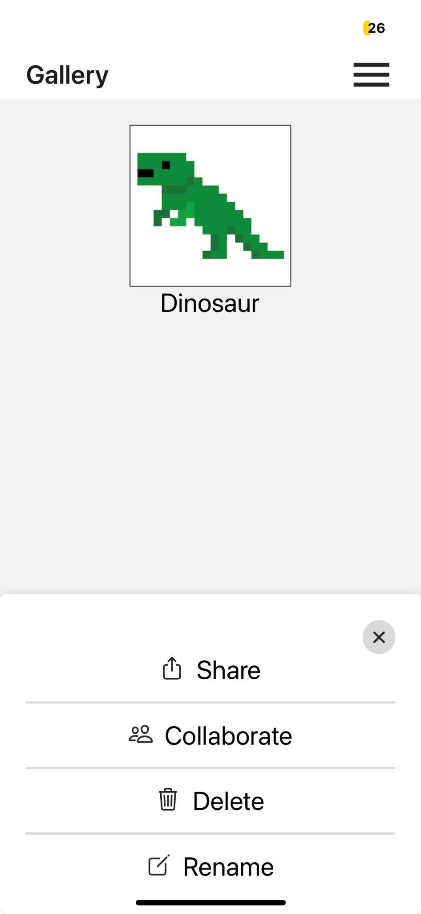
Gallery
Before
After

Slide 20
Gallery
Rationale
Before
8. Discard Drafts: no option to discard unwanted art
9. Visibility of Sharing: unclear how to share
10. Home page carousel: unclear what the carousel on the home page is
Centralized place to view user’s art
All actions relating to the user’s artwork accessible in one place
After

Slide 21
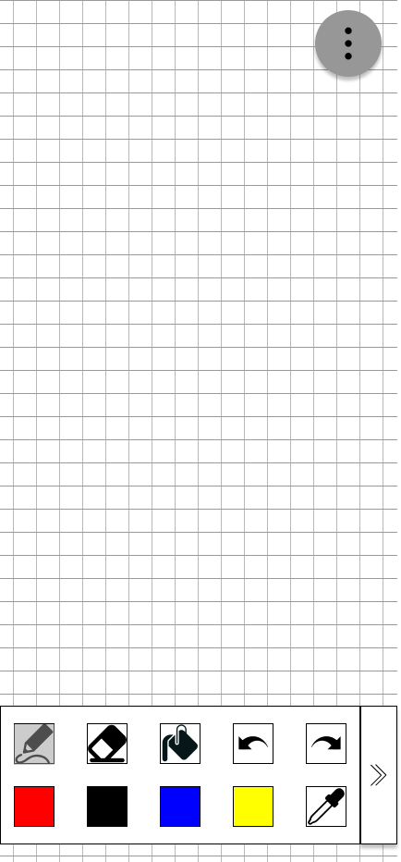
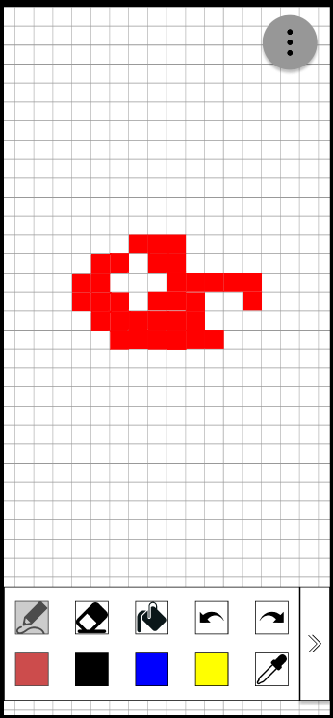
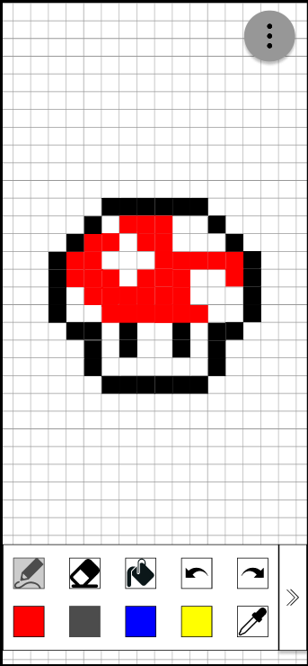
Canvas
Before

Slide 22
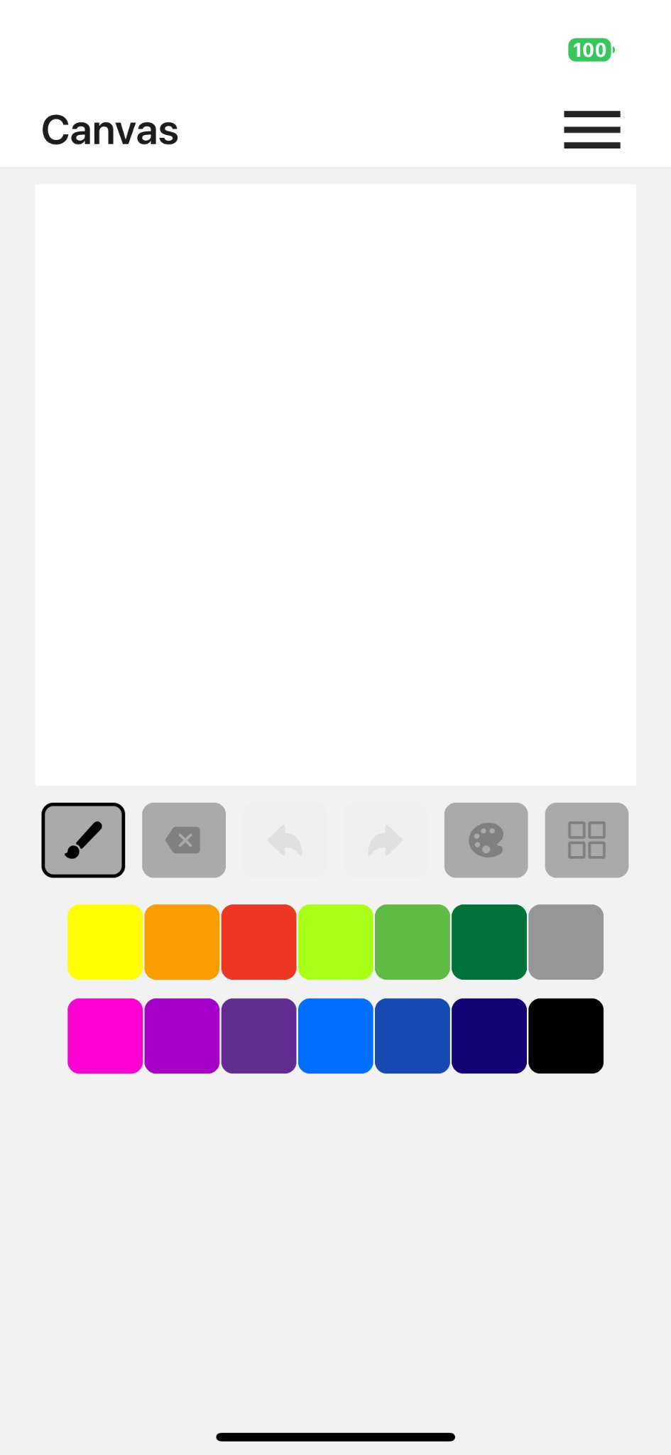
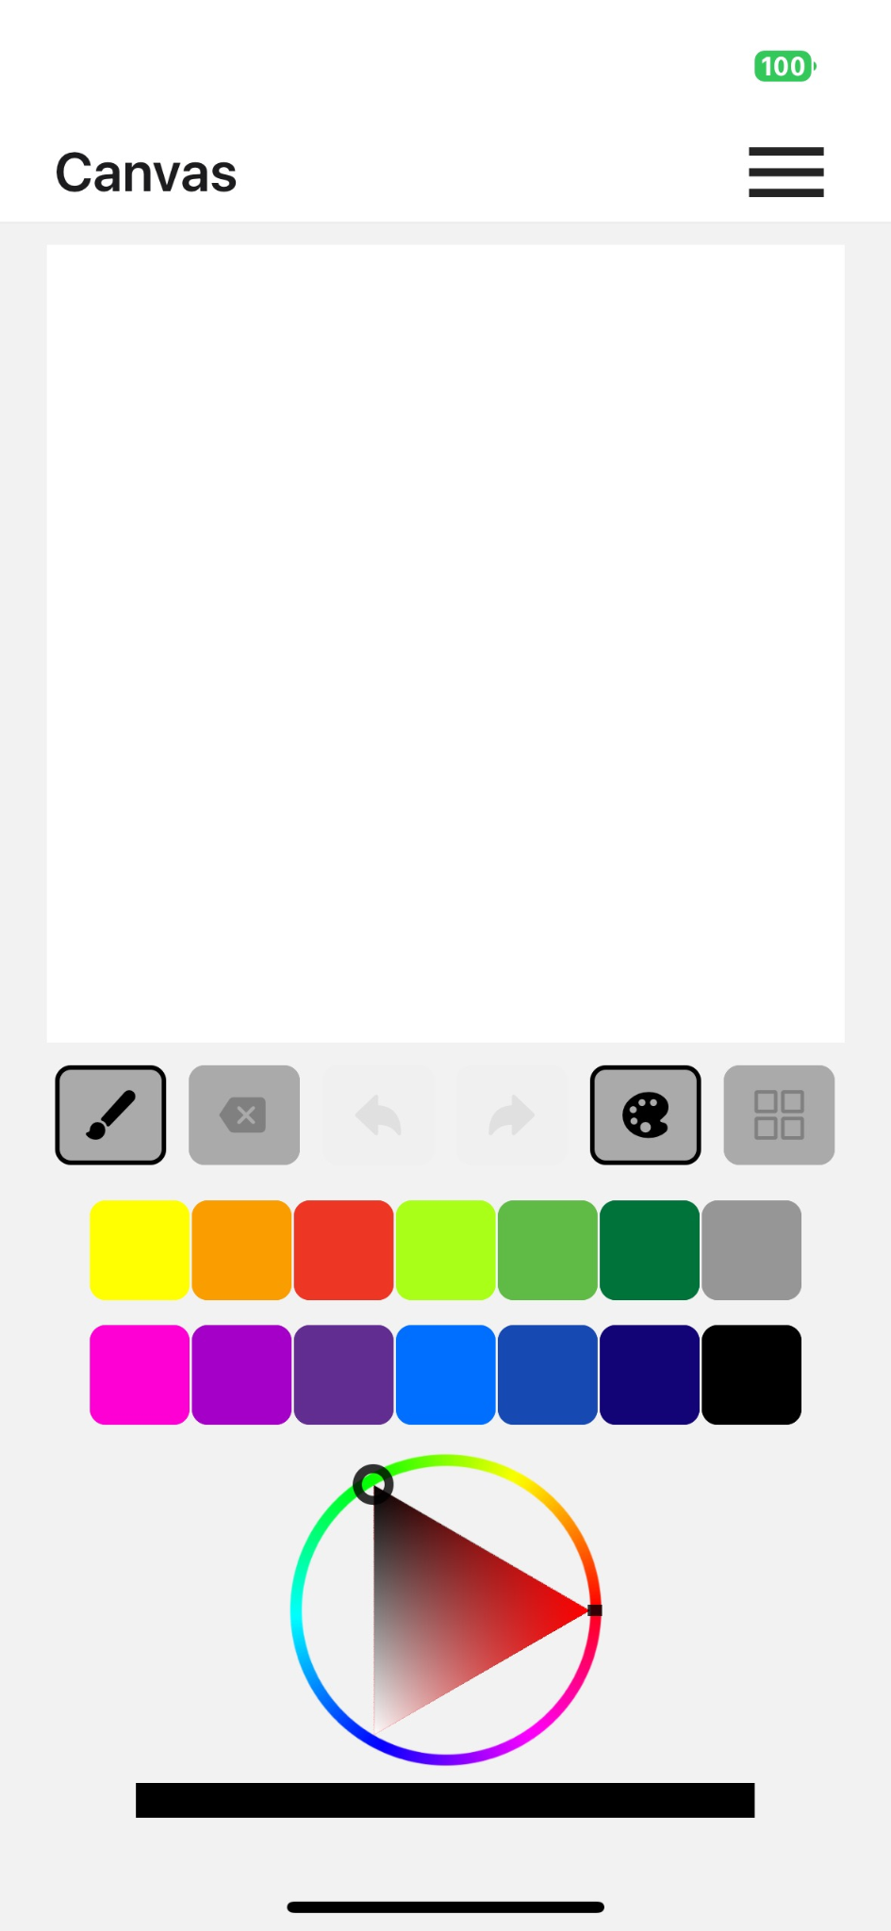
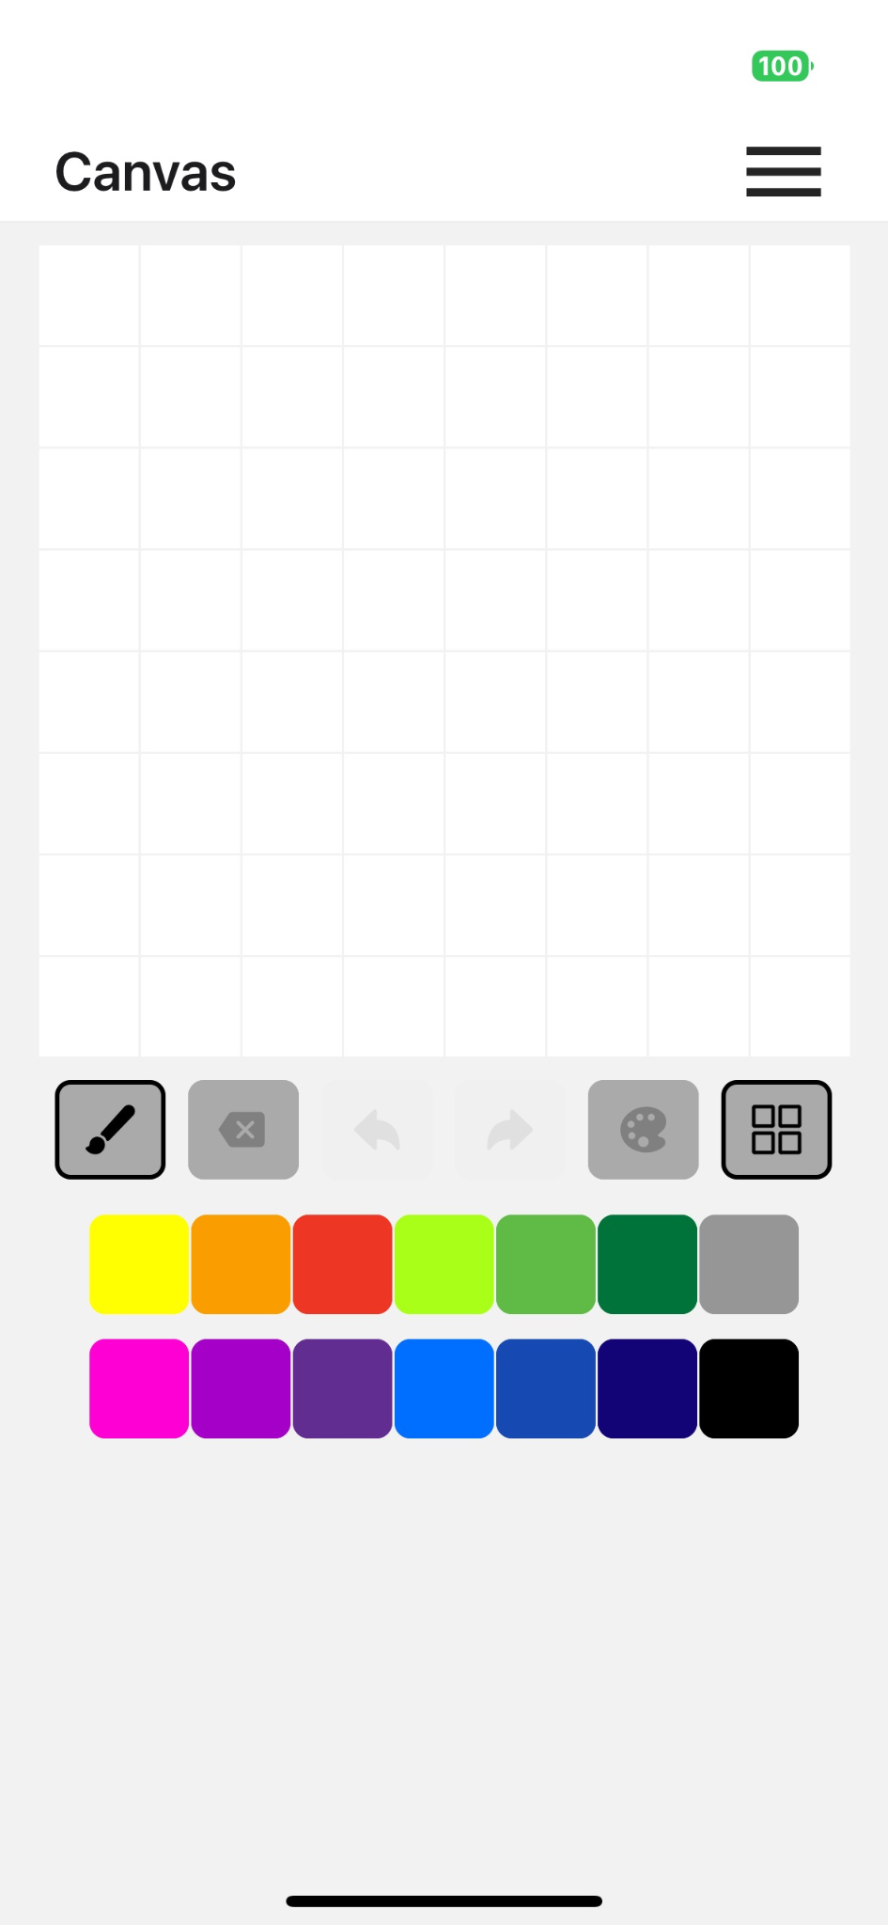
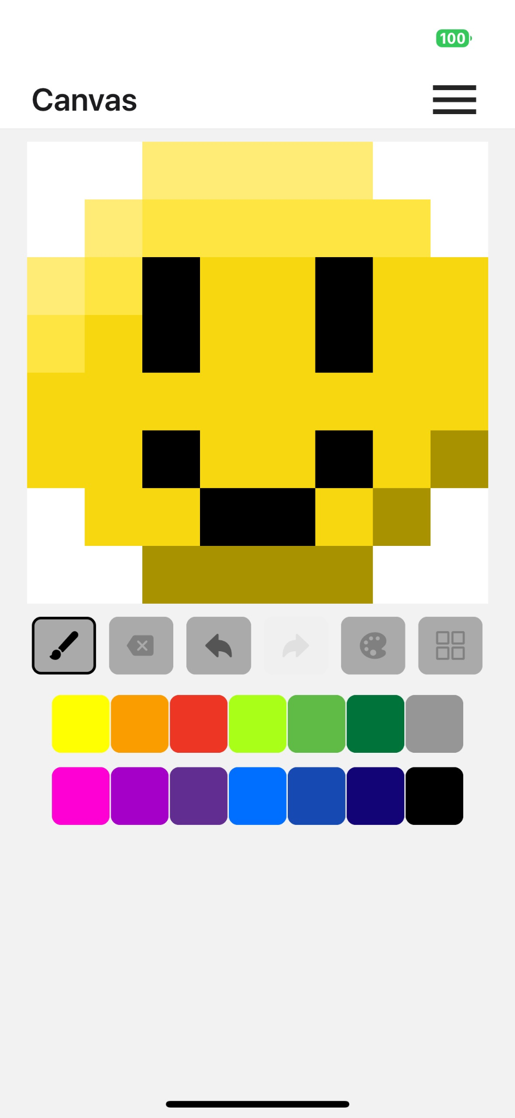
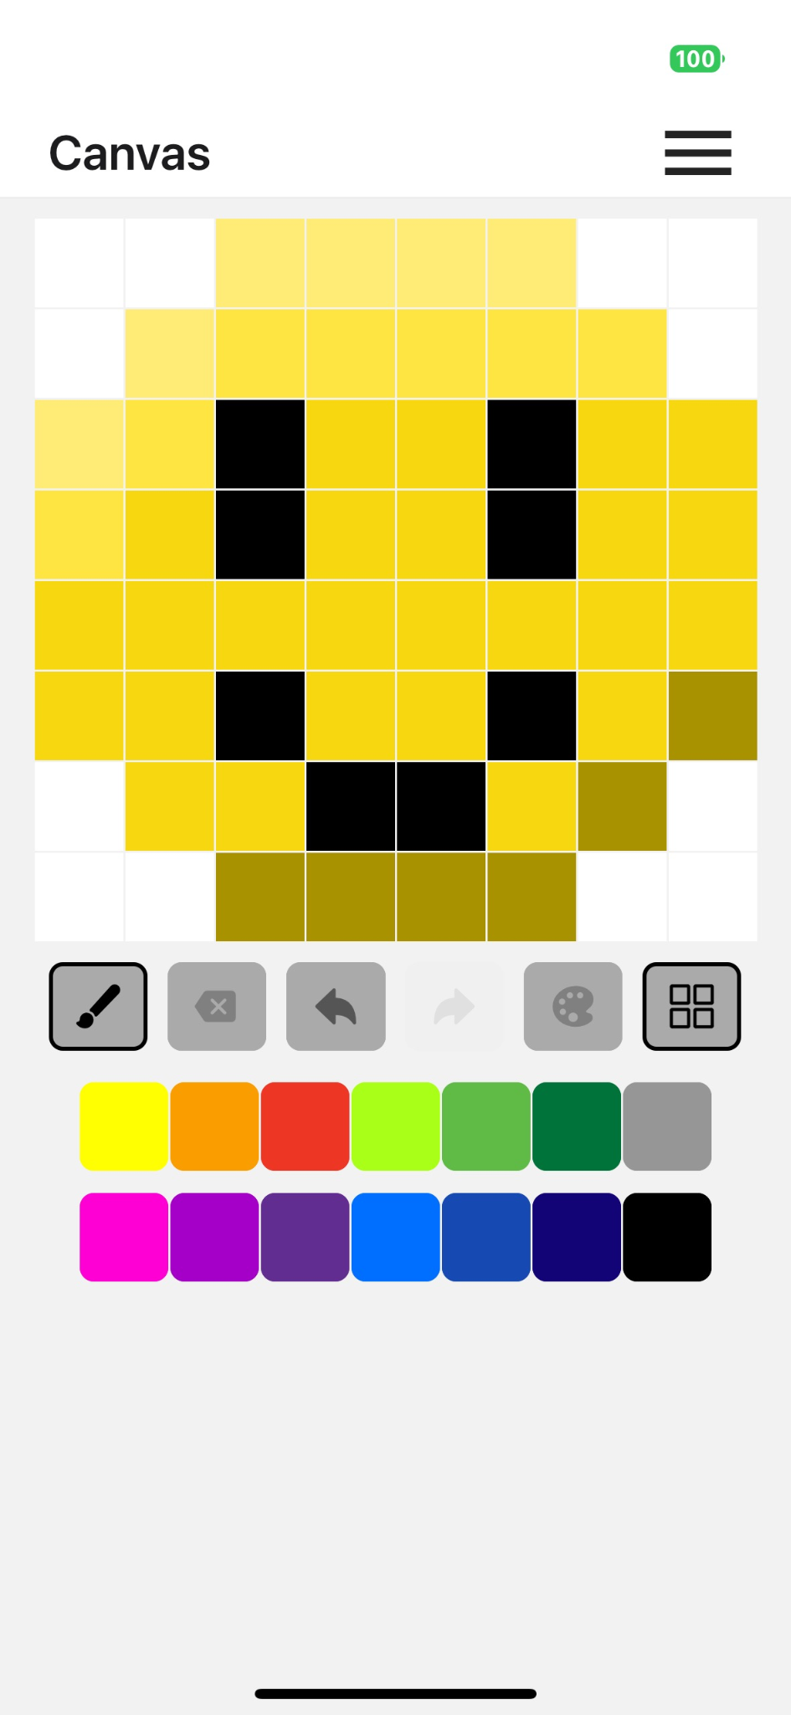
Canvas
After

Slide 23
Canvas
Rationale
Before
2. Pencil vs Bucket: no difference between pencil and bucket
12. Confusing canvas tools: unclear how to use tools on canvas
General Feedback: canvas tools were unclear and not beginner friendly
Simplified canvas interface
All tools immediately visible
After

Slide 24
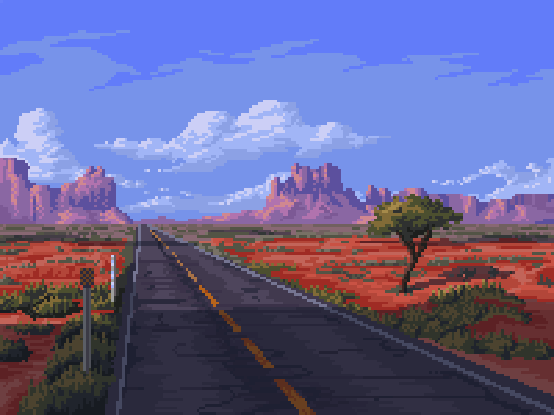
Progress toward usability goals
Simplified tasks to make it less error prone/more robust
Still interactive to keep the app fun
On track

Slide 25
Prototype Implementation Status

Slide 26





Tools used
React Native
Expo
VS Code
Figma
GitHub

Slide 27

Tasks
Task 1 (Simple) : Create pixel art piece
Task 2 (Moderate) : Share a pixel art piece
Task 3 (Complex) : Collaborate on a pixel artwork

Slide 28
Implemented Features
Task 1: Create a pixel art piece

Slide 29
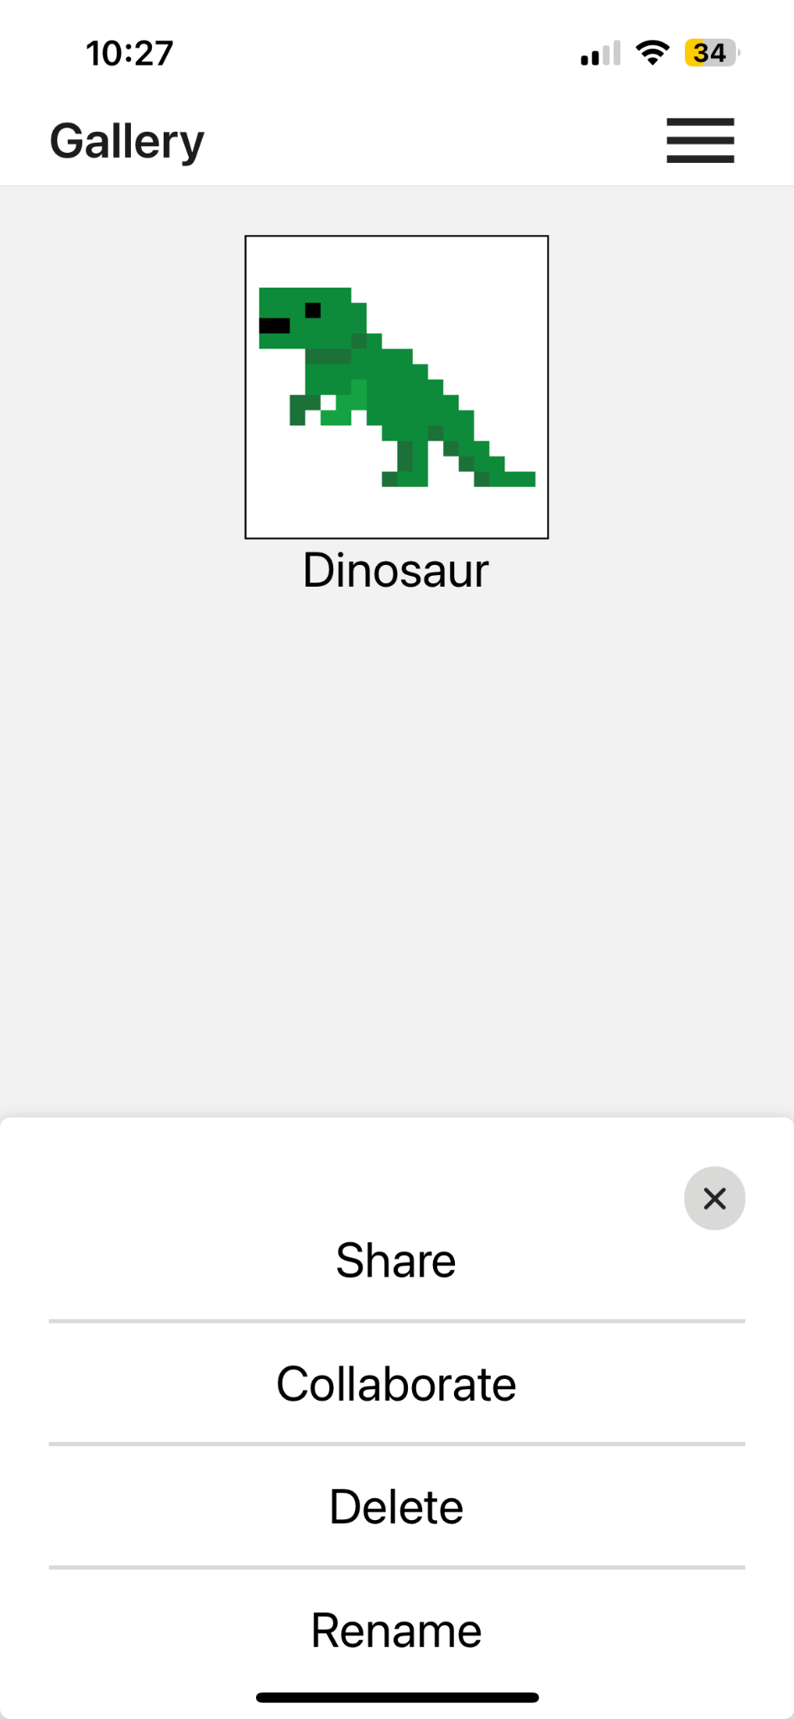


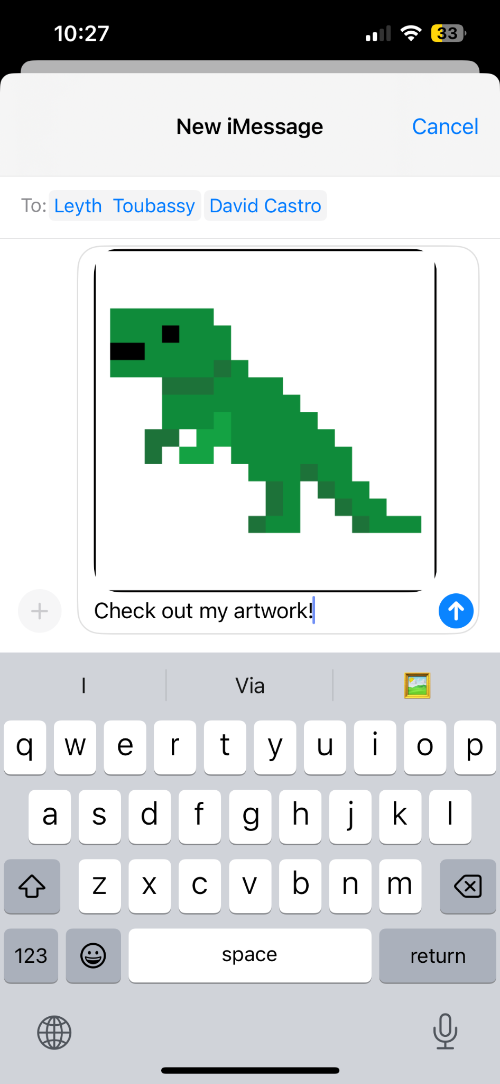
Implemented Features
Task 2: Share a pixel art piece

Slide 30

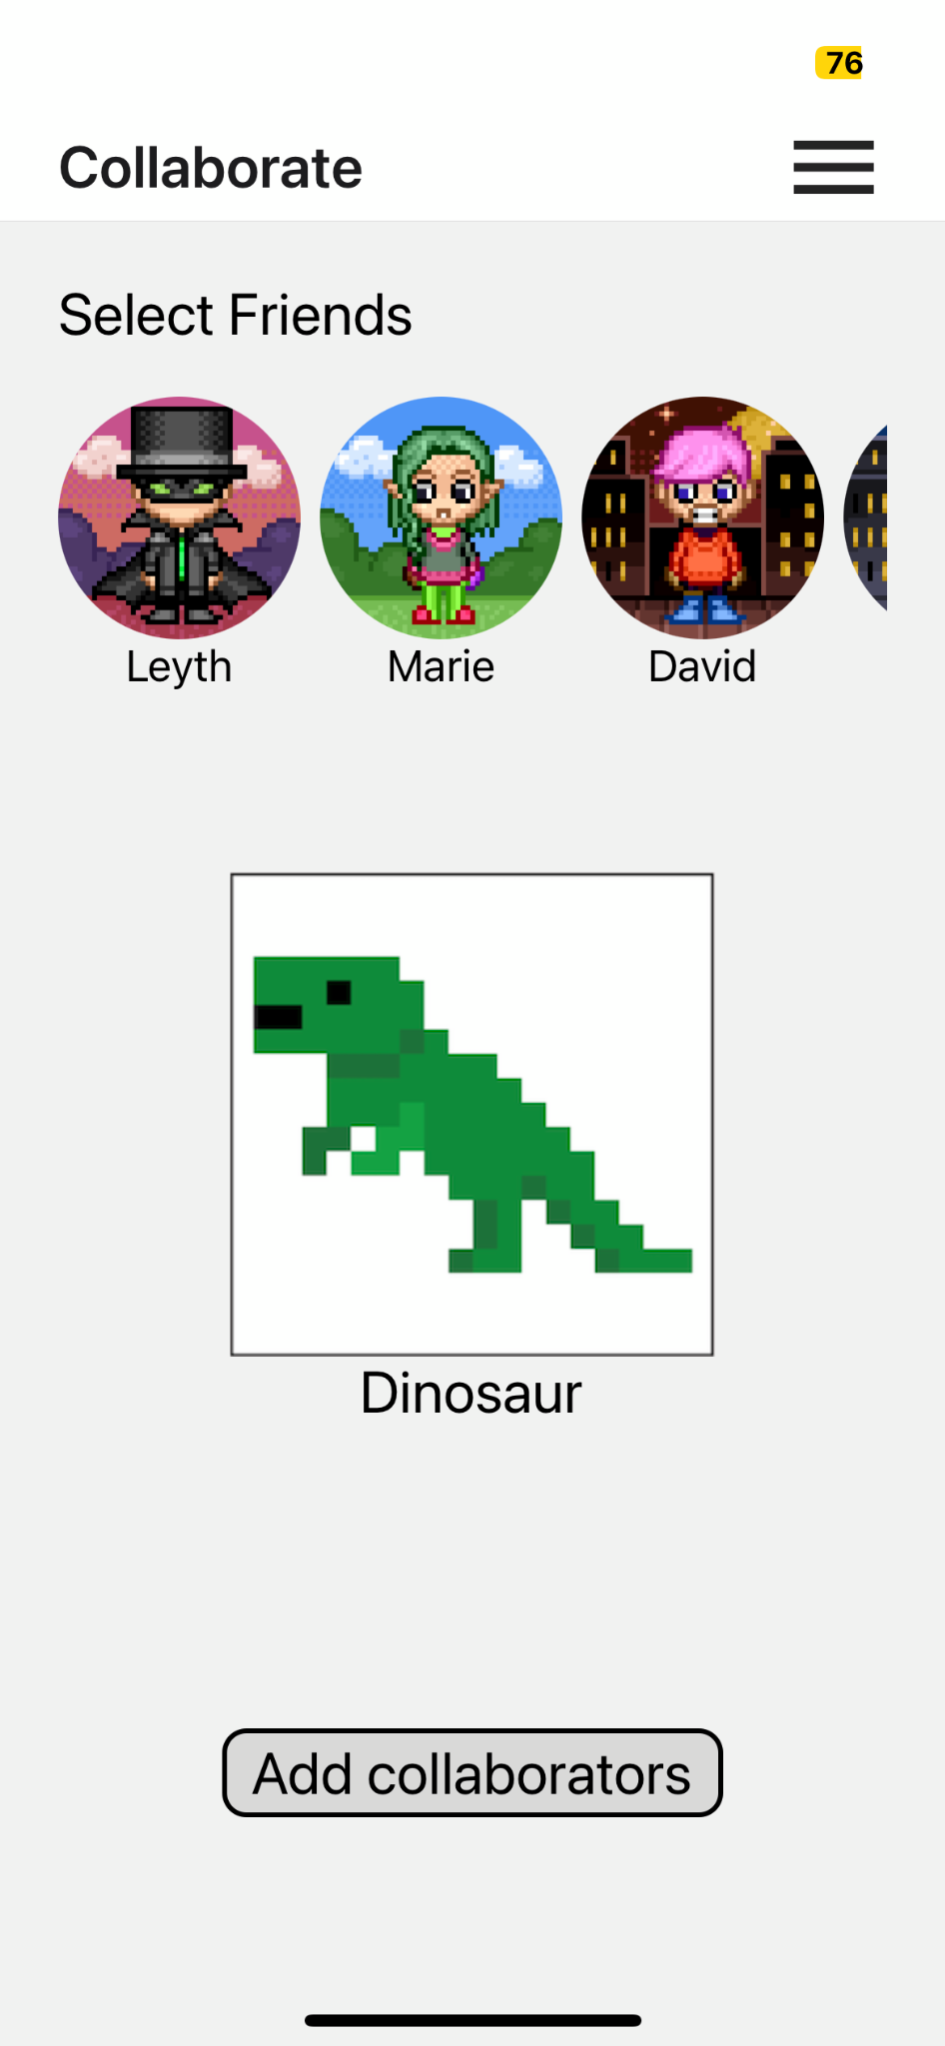

Implemented Features
Task 3: Collaborate on a pixel art piece

Slide 31

Features to be Implemented
Gallery page: Delete artwork and rename artwork
Lesson page: embedded video lessons
Home page: Collaborate button behavior
Canvas page: Save, reopen, share and collaborate on your artwork
Collaboration: simulated collaborator on canvas page, message collaborator
Walkthrough: create video tutorial walkthrough
All pages: styling and fonts

Slide 32
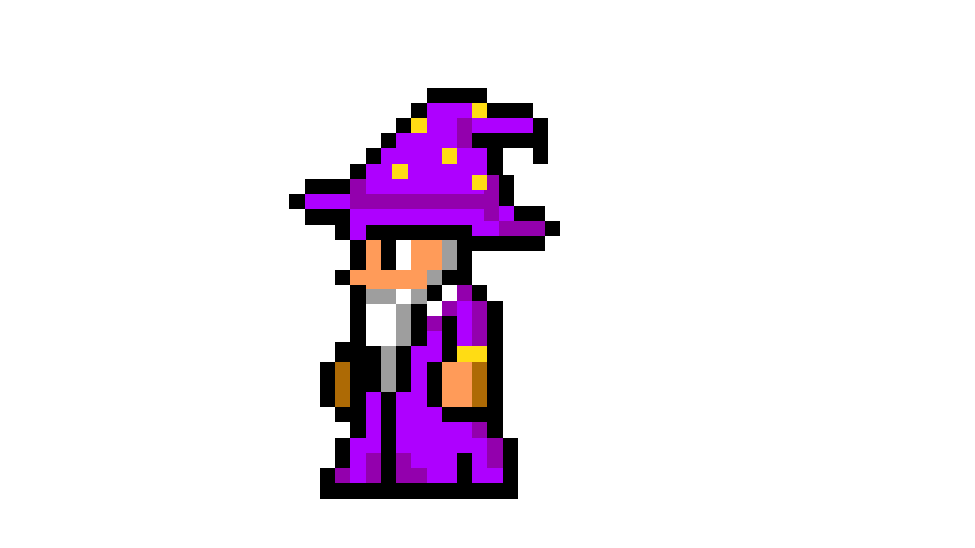
Wizard of Oz & Hardcoded
User already has some artwork populated when starting the app
Hardcoded friends with their numbers
Collaboration will be hard coded

Slide 33

Plan to finish
Finish report/poster draft, implement saving and persistence, create lessons page, gallery delete/rename
Record video walkthrough
Over the weekend
Thursday
Tuesday
If we have time
Build out messaging functionality, hardcode collaboration behavior, final font and styling check
Address more low severity heuristic violations

Slide 34
Live Demo

